Slide 1

Chapter 12 Session 10 + 11
How to use Ajax, JSON, and Flickr
Notes:
Session: Ghi số thứ tự session trong môn học
Session Name: ghi tên của session sẽ dạy

Slide 2
Objectives
Introduction to Ajax
How to use the jQuery shorthand methods for Ajax
How to use the $.ajax() method for working with Ajax
How to use Ajax with Flickr
Notes:
Mô tả nội dung mà học viên phải đạt được khi kết thúc môn học này

Slide 3
Introduction to Ajax
Notes:
Session: Ghi số thứ tự session trong môn học
Session Name: ghi tên của session sẽ dạy

Slide 4
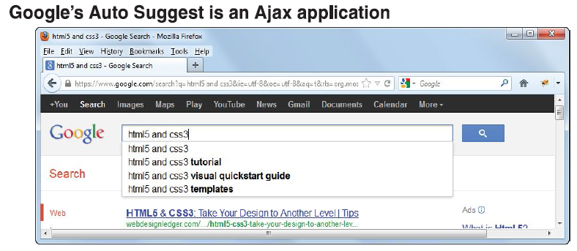
Introduction to Ajax
Ajax stands for Asynchronous JavaScript and XML.
Unlike normal HTTP request, Ajax let you receive data from web server without reloading the page.

Slide 5
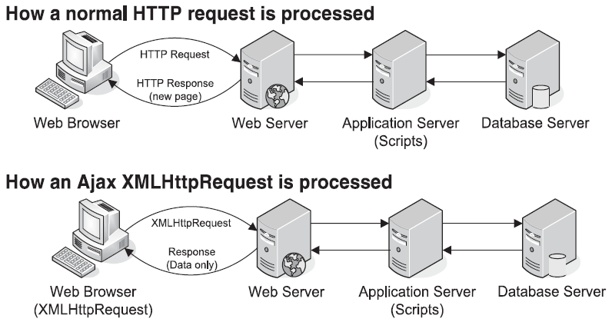
How Ajax works

Slide 6
How Ajax works (cont.)
Ajax need to use JavaScript to send the request, process the responses and updates the DOM with the new data.
To send an Ajax request, JavaScript uses a browser object known as XMLHttpRequest (XHR) object.
XHR Object can include data that tells the application server what data is being requested.

Slide 7
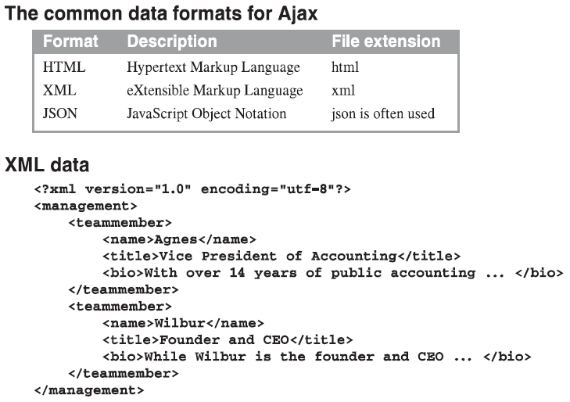
Common data formats for Ajax

Slide 8
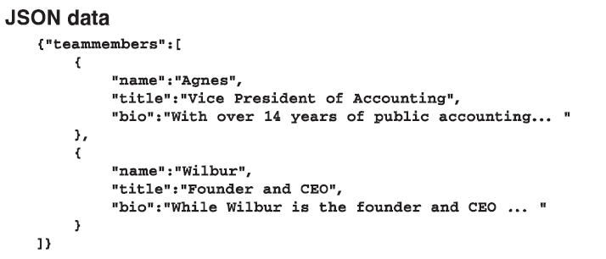
Common data formats for Ajax (cont.)

Slide 9
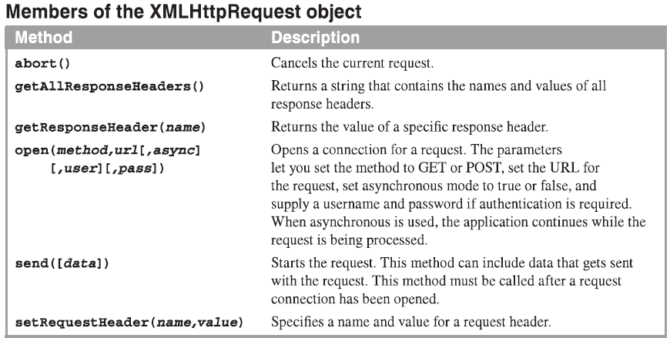
The members of the XMLHttpRequest object

Slide 10
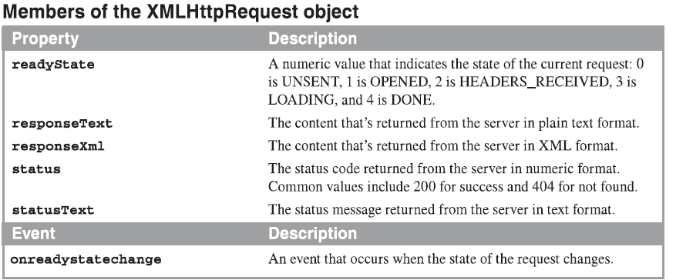
The members of the XMLHttpRequest object (cont.)

Slide 11
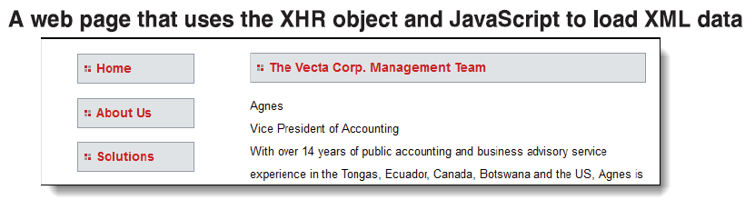
How to use the XMLHttpRequest object
This application uses the XHR object to load all of the team members in the file named team.xml on the web server and display them.

Slide 12
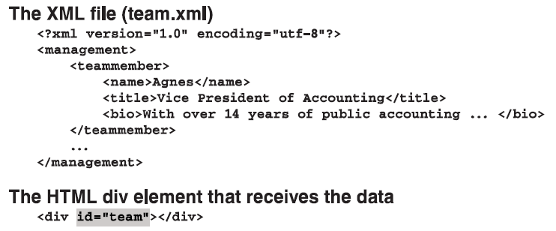
How to use the XMLHttpRequest object (cont.)

Slide 13
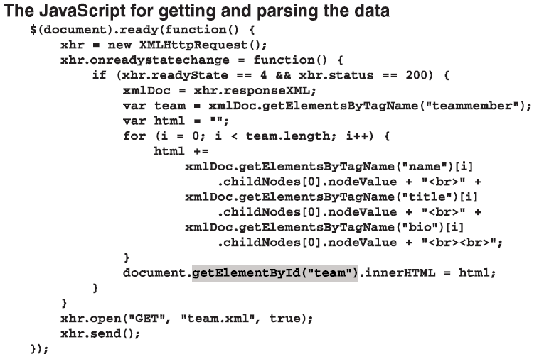
How to use the XMLHttpRequest object (cont.)

Slide 14
How to use the jQuery shorthand methods for Ajax
Notes:
Session: Ghi số thứ tự session trong môn học
Session Name: ghi tên của session sẽ dạy

Slide 15
The jQuery shorthand methods for working with Ajax
jQuery includes several shorthand methods that let you request and receive HTML, XML or JSON data.
All of the shorthand methods let you include data that will be used by the web server to filter the results of the request so only right the results are returned.
The $.get() and $.post() method are used for request (GET or POST).
The $each() method is an expanded form of the each() method.

Slide 16
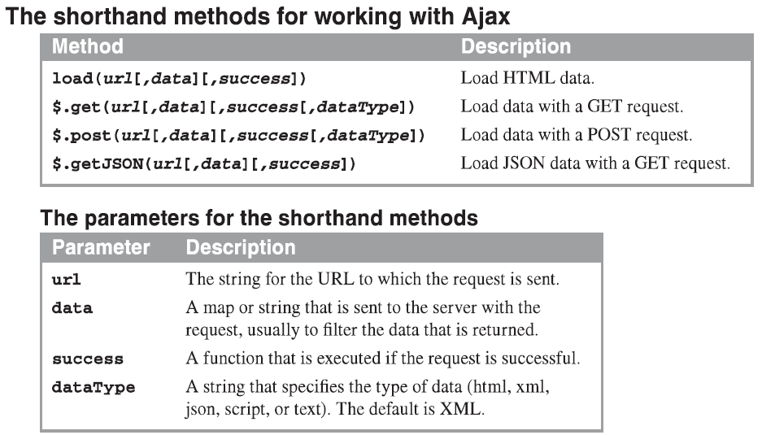
The jQuery shorthand methods for working with Ajax (cont.)

Slide 17
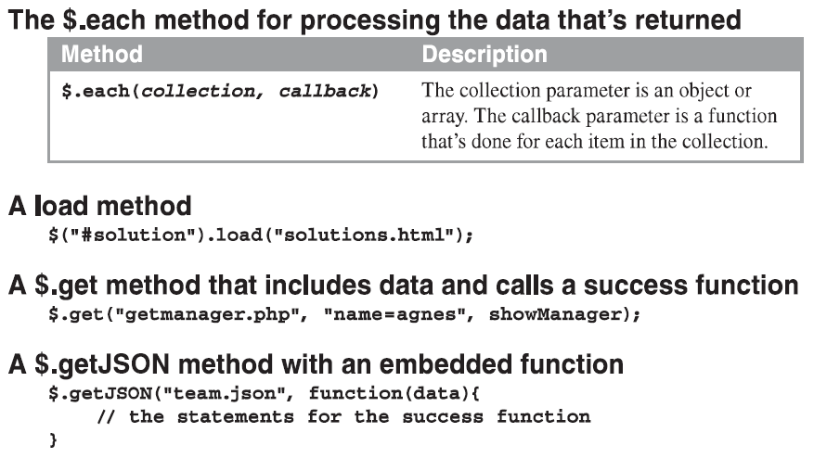
The jQuery shorthand methods for working with Ajax (cont.)

Slide 18
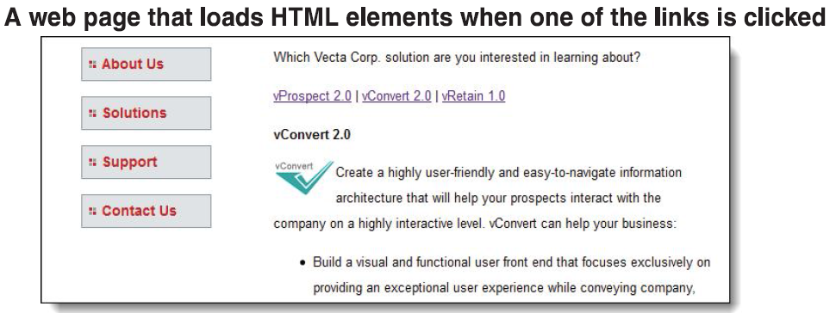
How to use the load() method to load HTML data
The load() function can only load content from files on the same server as the page making the call.

Slide 19
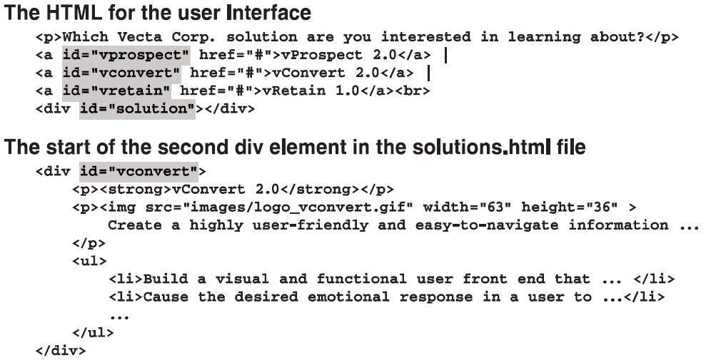
How to use the load() method to load HTML data (cont.)

Slide 20
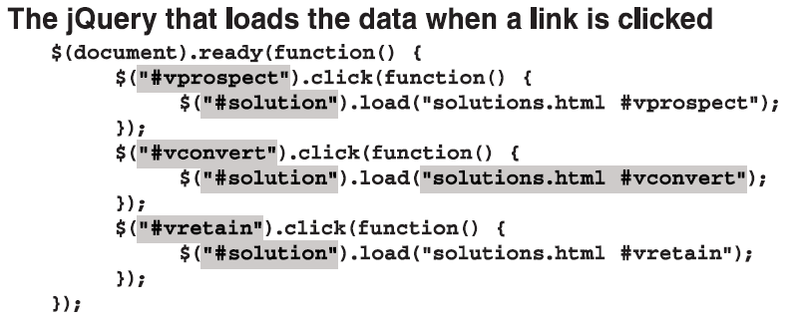
How to use the load() method to load HTML data (cont.)

Slide 21
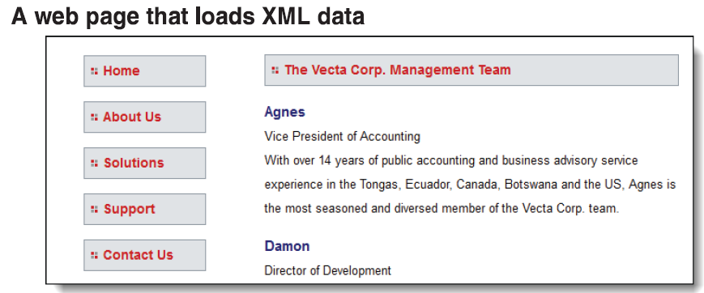
How to use the $.get() or $.post() method to load XML data

Slide 22
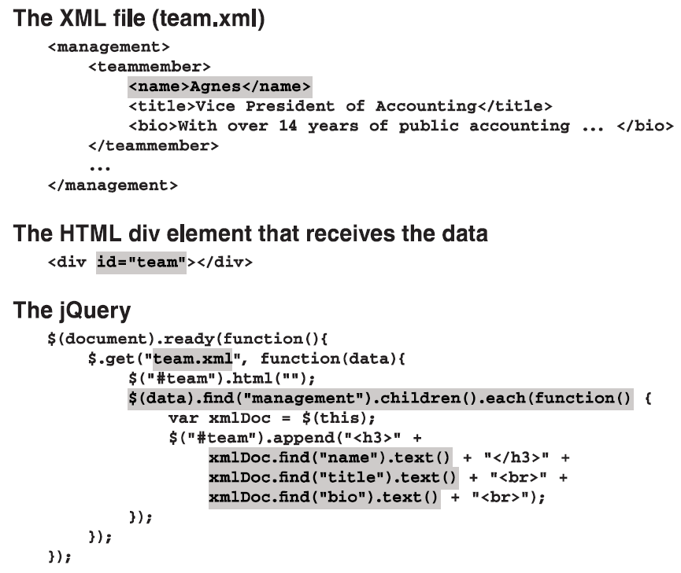

Slide 23
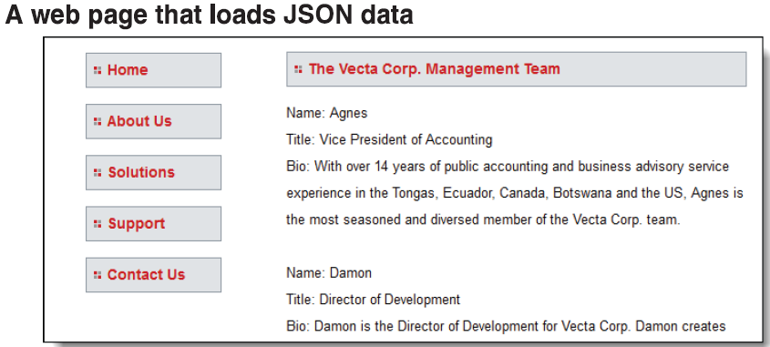
How to use the $.getJSON() method to load JSON data

Slide 24
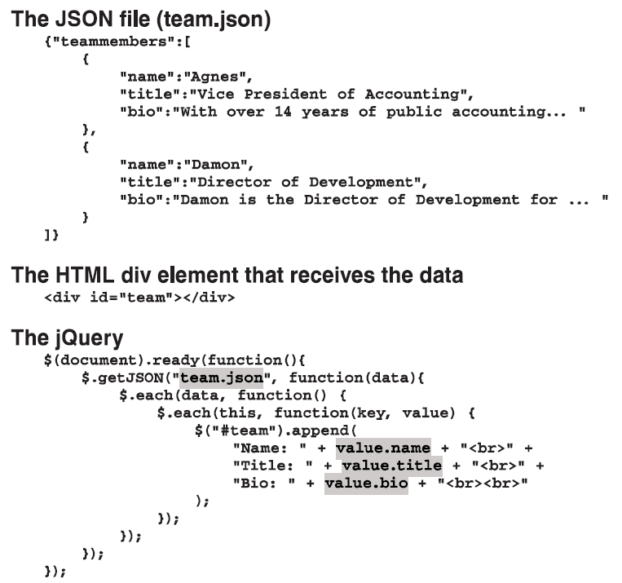

Slide 25
How to send data with an Ajax request
When you send data with an Ajax request, the URL is for a server-side script such as a PHP file. Then, the script is responsible for returning the data in XML or JSON format.
The data parameter in a jQuery shortcut method is a name/value pair that can be set either as query string or a map.
The jQuery helper functions for Ajax make it easy to package form data before sending it to the server.

Slide 26
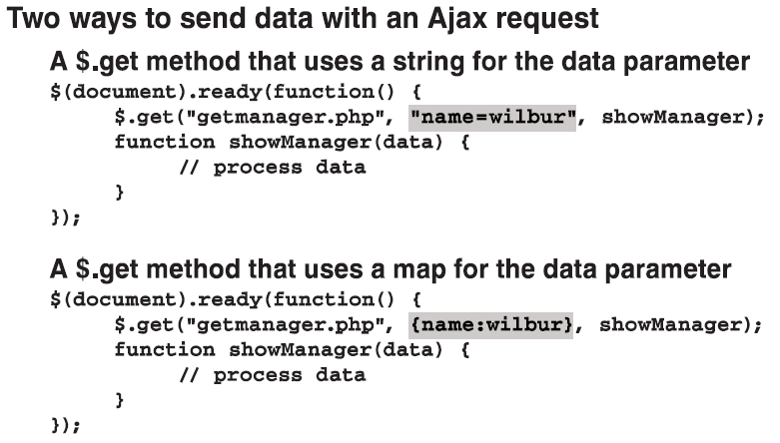
How to send data with an Ajax request (cont.)

Slide 27
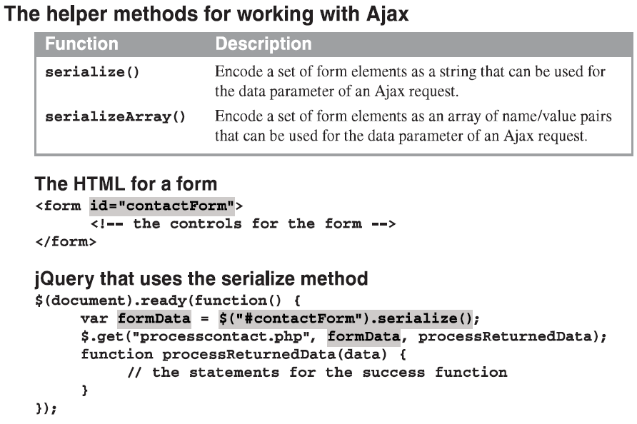
How to send data with an Ajax request (cont.)

Slide 28
How to use the $.ajax() method for working with Ajax
Notes:
Session: Ghi số thứ tự session trong môn học
Session Name: ghi tên của session sẽ dạy

Slide 29
The syntax of the $.ajax() method
$.ajax(){}
The $.ajax() method provides options that give you more control over the way the Ajax request works, such as providing a function for handling errors.

Slide 30
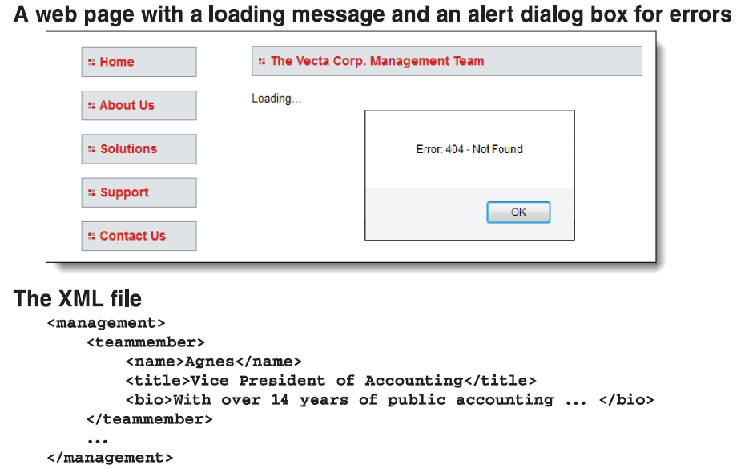
How to use the $.ajax() method to load data

Slide 31
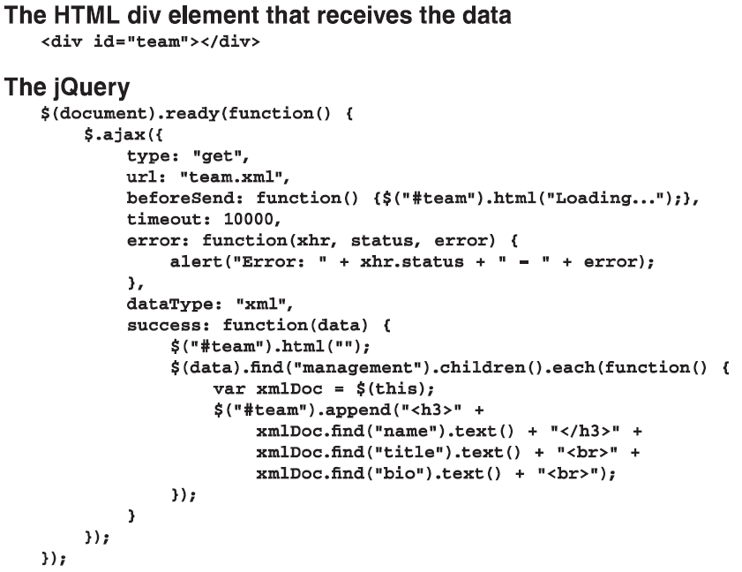
How to use the $.ajax() method to load data (cont.)

Slide 32
The End.

